Slide 1
Orthogonality and Least Squares
5.5 Least-Squares Problems
Bumhee Cho

Slide 2







Slide 3



Least-Squares Solution
If A is an m × n and b is in ℝ^{m}, a least-squares solution of Ax = b is an x in ℝ^{n} such that
for all x in ℝ^{n}.
b
Ax
0
Subspace of ℝ^{m}
Col A
Ax
dim Col A ≤ n

Slide 4





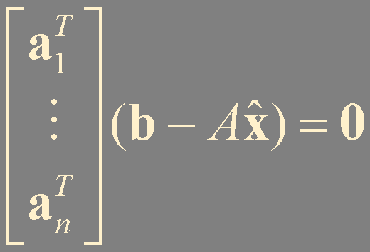



b
Subspace of ℝ^{m}
0
dim Col A ≤ n
= proj_{Col A}b
Col A
is consistent !
ℝ^{n}
A
Col A
orthogonal !
A = [a₁ a₂ ⋯ a_{n}]
A^{T}Ax = A^{T}b
normal equations for Ax = b

Slide 5




Theorem 13.
The set of least-squares solutions of Ax = b coincides with the nonempty set of solutions of the normal equations A^{T}Ax = A^{T}b.
Theorem 8. The Orthogonal Decomposition Theorem
A^{T}(b - Ax) = 0
Let W be a subspace of ℝ^{n}. Then each y in ℝ^{n} can be written uniquely in the form
y = y + z
where y is in W and z is in W⊥.
b - Ax is orthogonal to Col A
unique orthogonal decomposition
must be the orthogonal projection of b onto Col A.

Slide 6


Least-Squares Error
When a least-squares solution x is used to produce Ax as an approximation to b, the distance from b to Ax is called least-squares error of this approximation

Slide 7
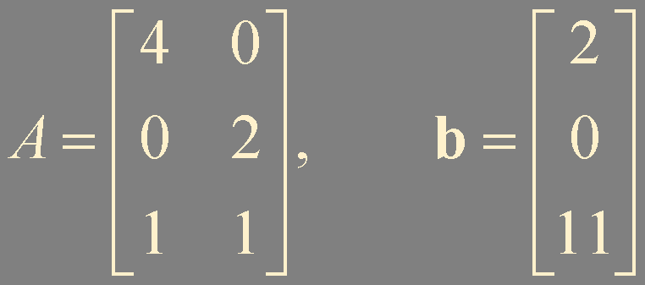

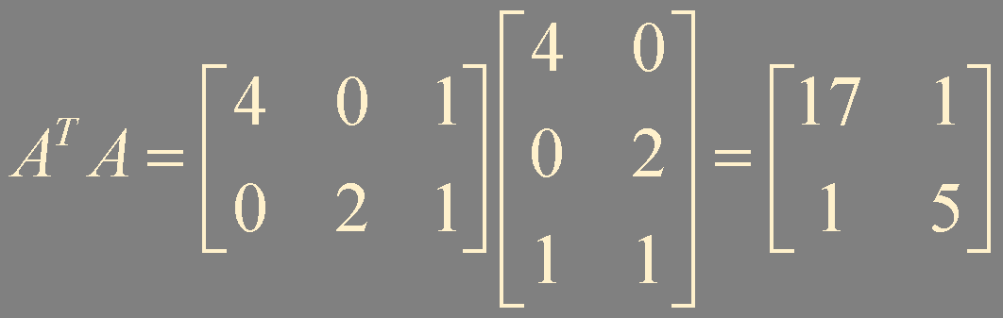
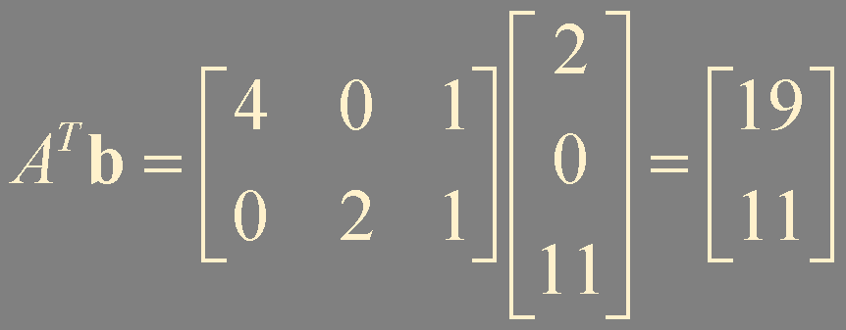
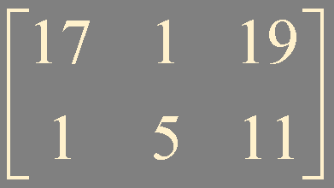

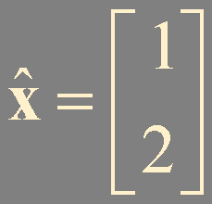
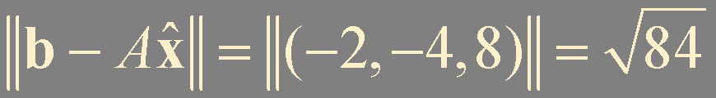

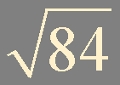
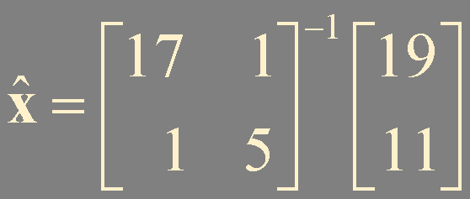
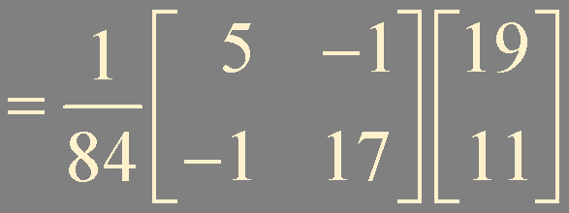
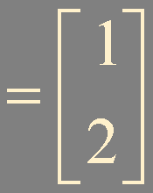
?
!
Find a least-squares solution of the inconsistent system Ax = b for
Example 1
(2, 0, 11)
(0, 2, 1)
0
(4, 0, 1)

Slide 8
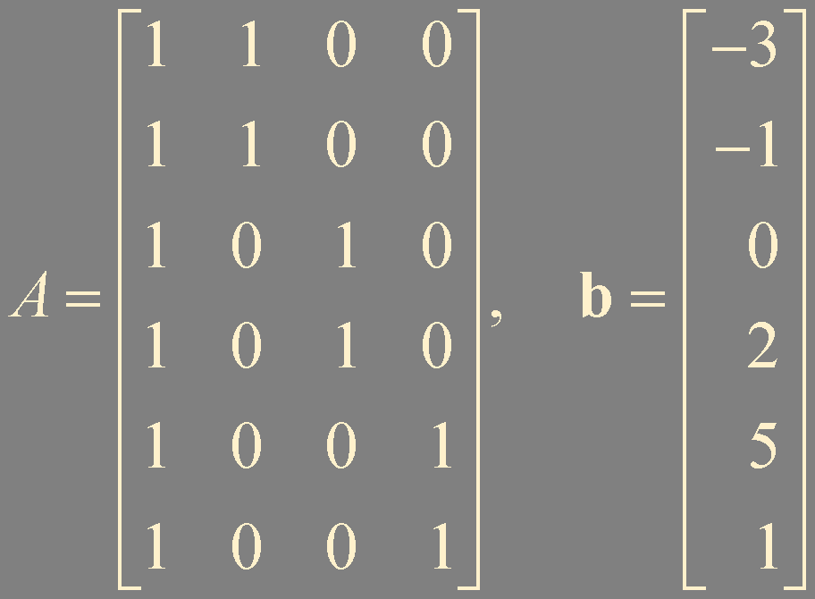
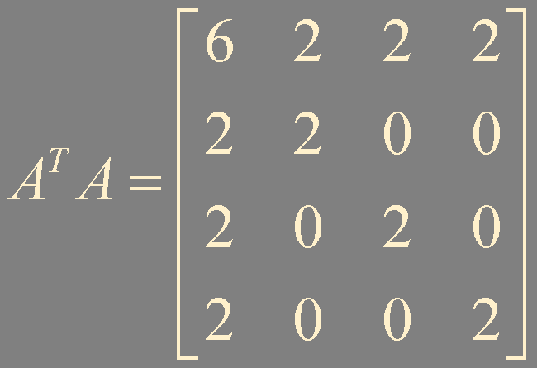
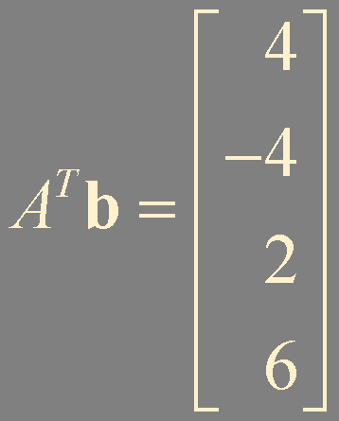
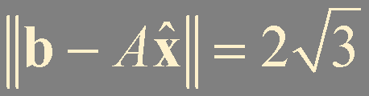
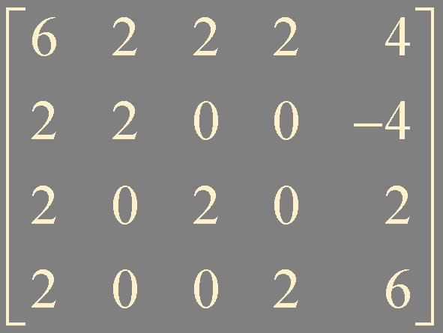
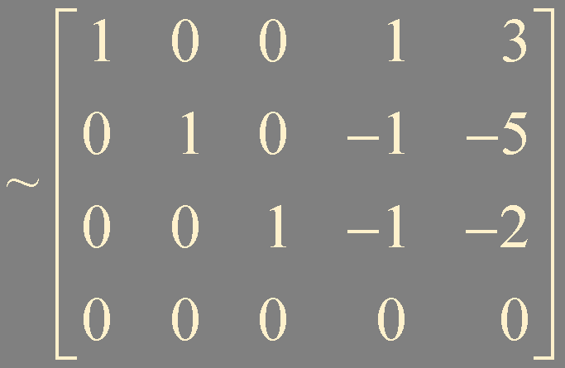
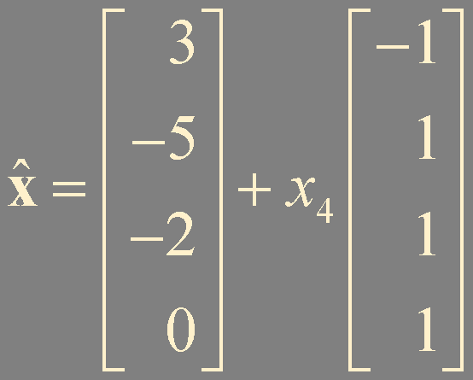
?
!
Find a least-squares solution of Ax = b for
Example 2

Slide 9

?
!
Let A be an m × n matrix. Show that a vector x in ℝ^{n} satisfies Ax = 0 if and only if A^{T}Ax = 0.
Example 3
Ax = 0
A^{T}Ax = A^{T}0 = 0
A^{T}Ax = 0
x^{T}A^{T}Ax = x^{T}0 = 0
Nul A = Nul A^{T}A
(Ax)^{T}(Ax) = 0
||Ax|| = 0
Ax = 0
?
!
Let A be an m × n matrix such that A^{T}A is invertible. Show that the columns of A are linearly independent.
Example 4
A^{T}Ax = 0
has only trivial solution !
Ax = 0

Slide 10
?
!
Let A be an m × n whose columns are linearly independent.
Show that A^{T}A is invertible.
Explain why m ≥ n.
Determine the rank of A.
Example 5
Ax = 0
Ch 1.6 Theorem 8.
has only trivial solution !
If a set contains more vectors than there are entries in each vector,
A^{T}Ax = 0
then the set is linearly dependent
n linearly independent column vectors are in ℝ^{m}
rank of A = dim Col A = n

Slide 11

Theorem 14.
The matrix A^{T}A is invertible if and only if the columns of A are linearly independent.
In this case, the equation Ax = b has only one least-squares solution x, and it is given by

Slide 12



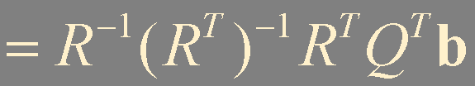
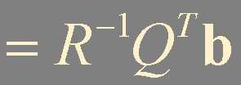

Theorem 15.
Given an m × n matrix A with linearly independent columns, let A = QR be a QR factorization of A. Then,
for each b in ℝ^{m}, the equation Ax = b has a unique least-squares solution, given by

Slide 13
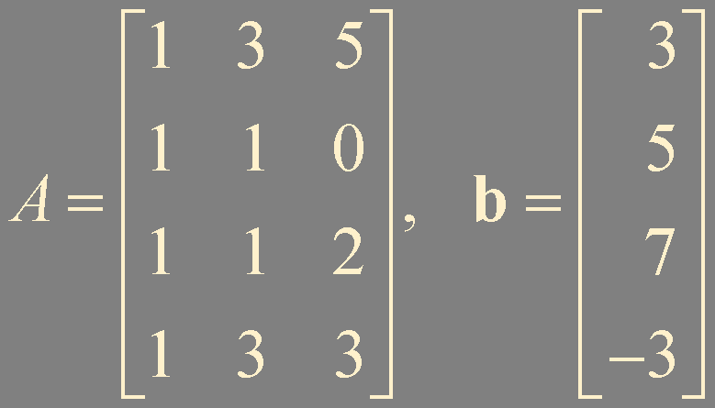
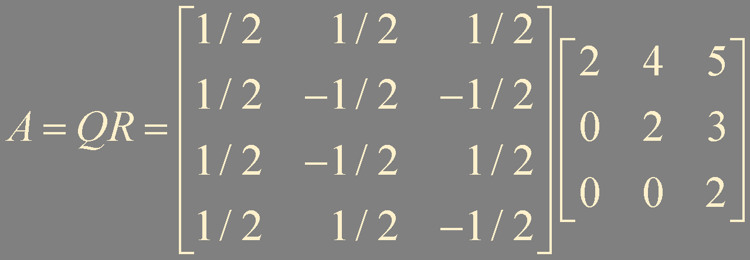
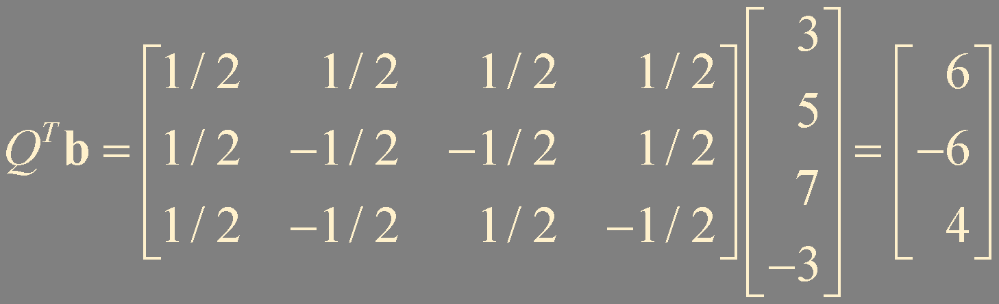
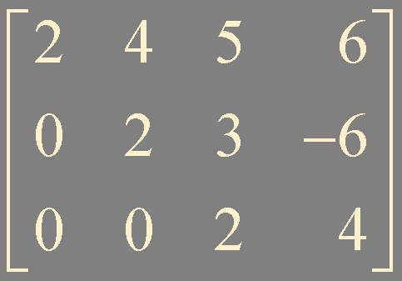
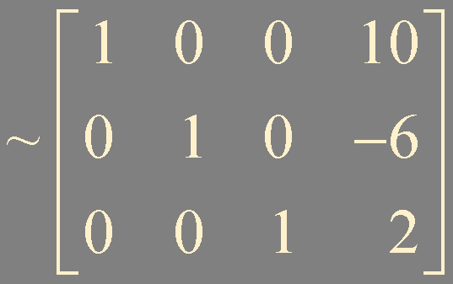
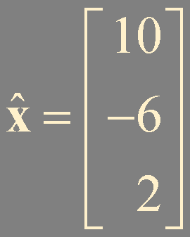

?
!
Find a least-squares solution of Ax = b for
Example 6

Slide 14
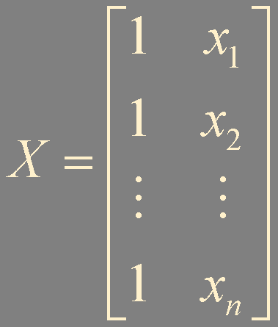
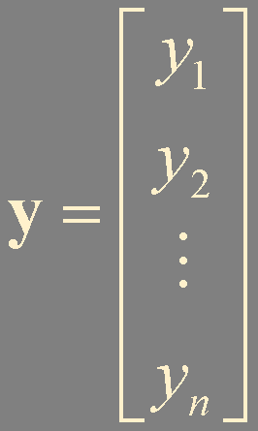
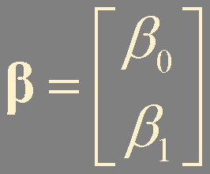


Least-Squares Lines
predicted
y-value
Observed
y-value
y
(x₂, y₂)
β₀ + β₁x₁
y₁
=
β₀ + β₁x₂
=
y₂
(x₁, y₁)
⋮
⋮
y = β₀ + β₁x
β₀ + β₁x_{n}
=
y_{n}
(x_{n}, y_{n})
x

Slide 15
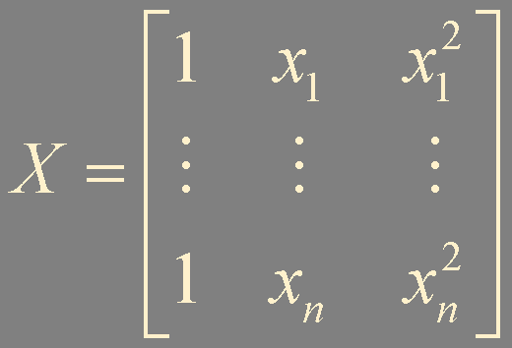
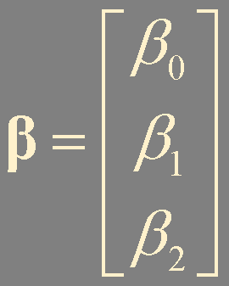
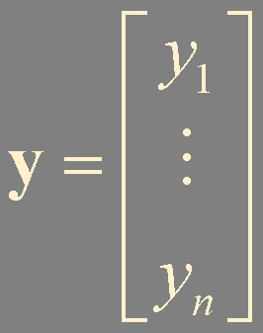
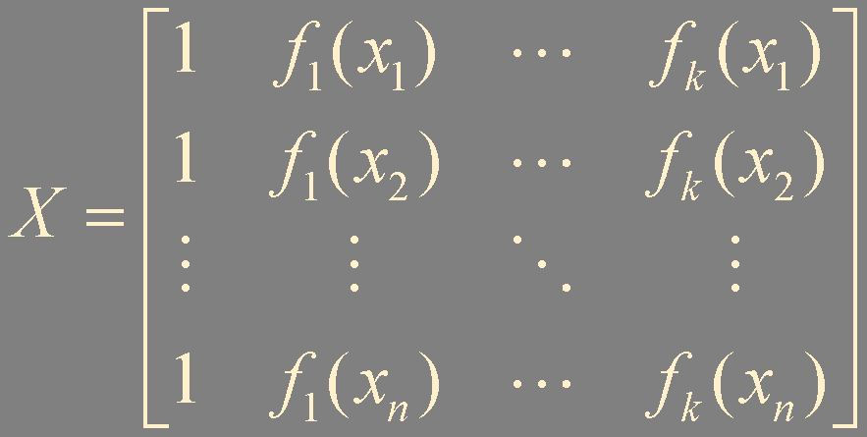
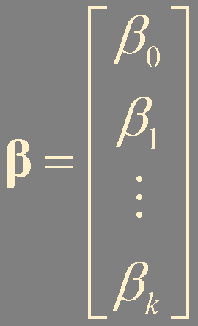
Least-Squares Fitting of Other Curves
y = β₀ + β₁x + β₂x²
predicted
y-value
Observed
y-value
β₀ + β₁x₁ + β₂x₁²
=
y₁
⋮
⋮
β₀ + β₁x_{n} + β₂x_{n}²
=
y_{n}
y = β₀ + β₁ f₁(x) + ⋯ + β_{k} f_{k}(x)

Slide 16
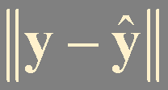
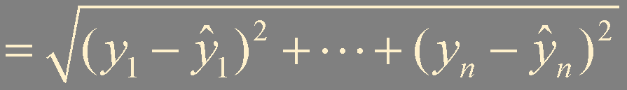
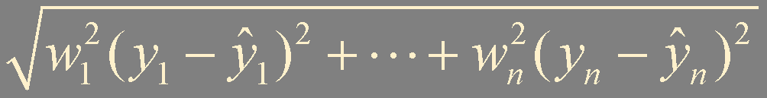
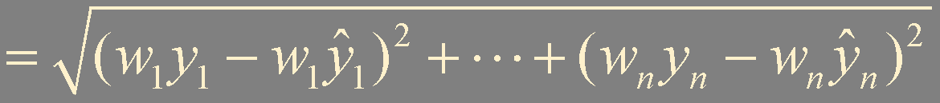
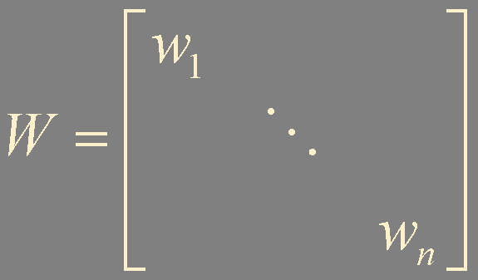



Weighted Least-Squares (Advanced Topic)

Slide 17
Summary
Least-squares problems and solutions
Least-squares fitting

